Slide 1
Discrete Math

Slide 2
Logic and Induction
Predicate Logic
Predicate logic is an extension of propositional logic that permits concisely reasoning about whole classes of entities.
E.g., “x>1”, “x+y=10”
Such statements are neither true or false when the values of the variables are not specified.

Slide 3
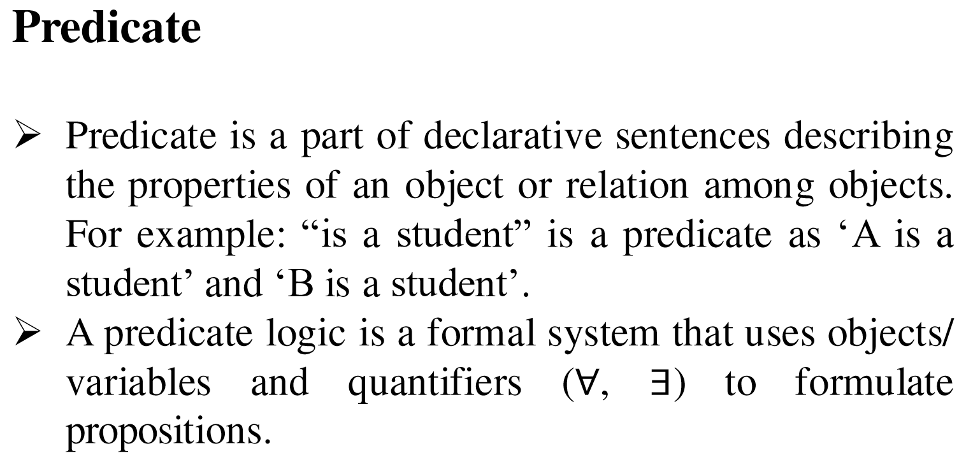

Slide 4
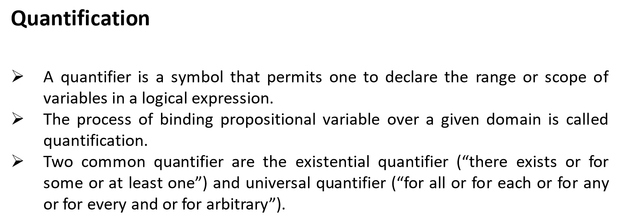

Slide 5
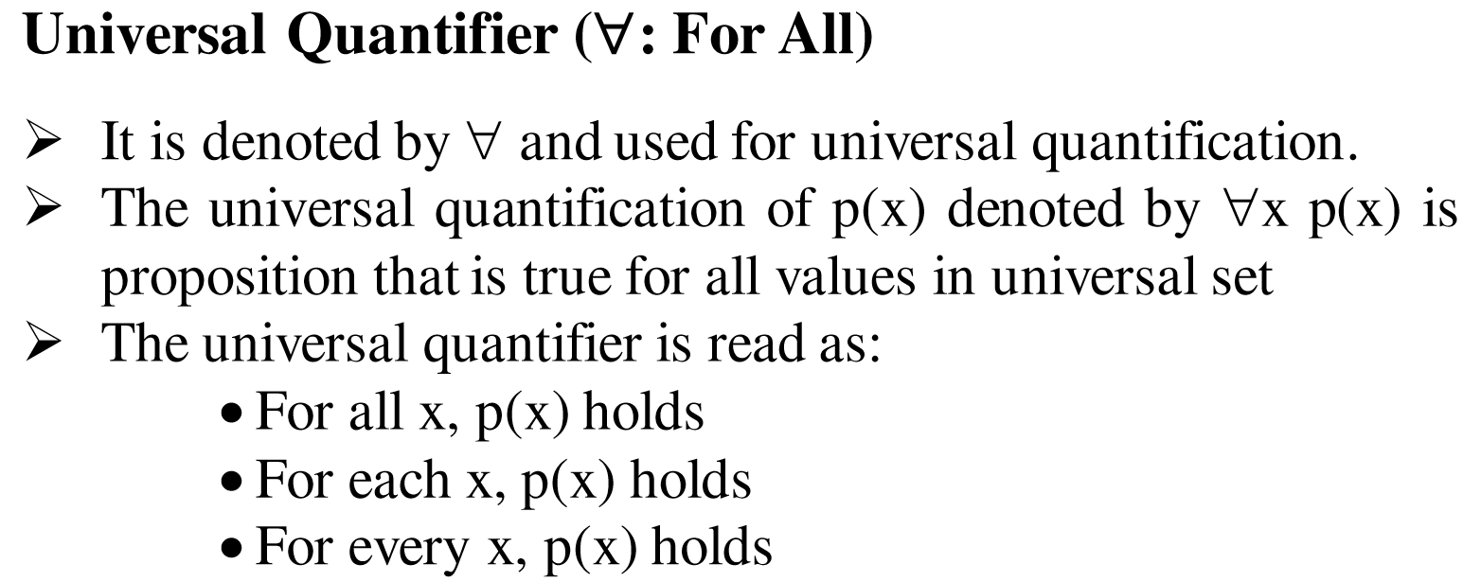

Slide 6
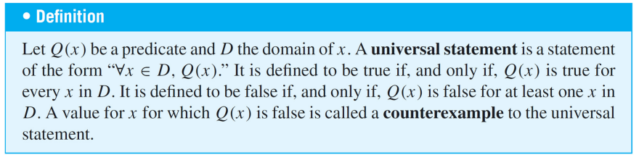

Slide 7
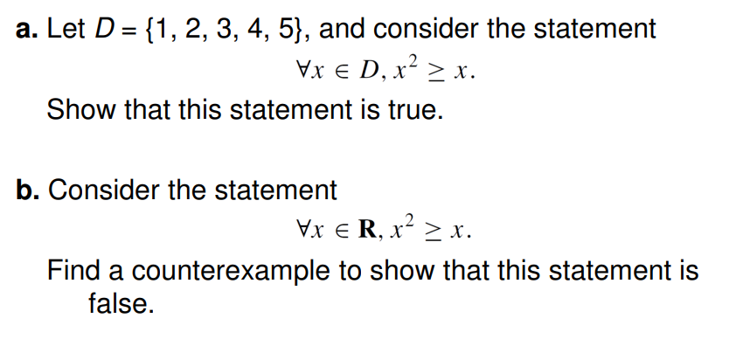
Example

Slide 8
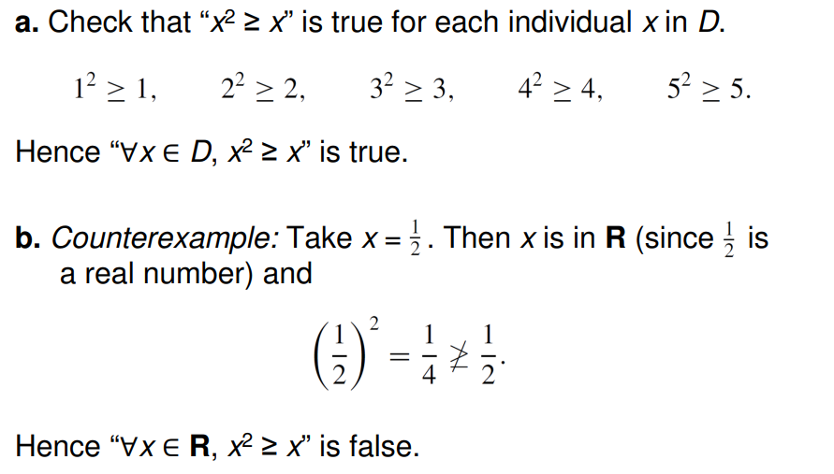

Slide 9
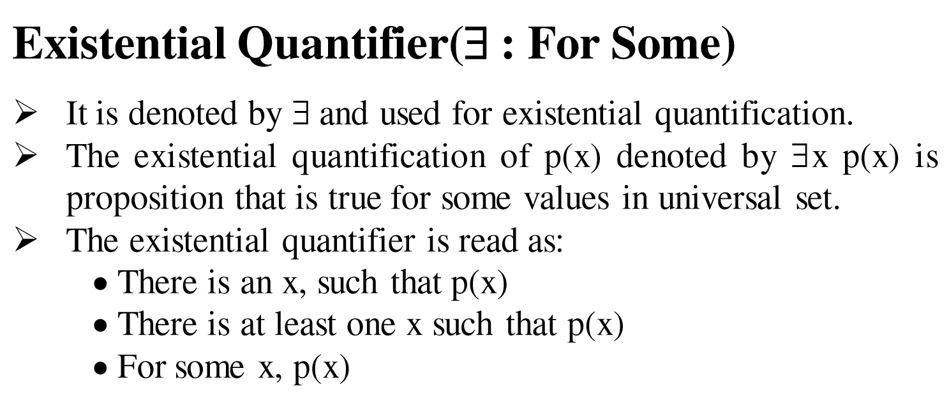

Slide 10
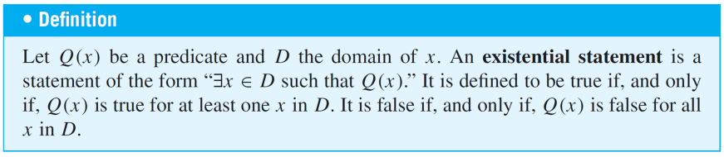

Slide 11
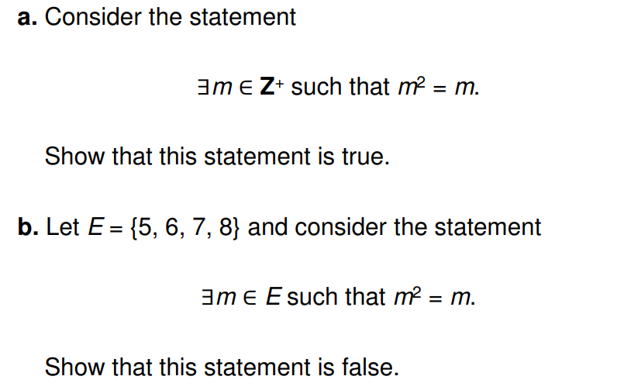

Slide 12
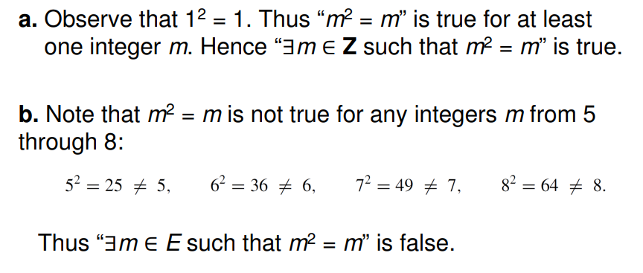

Slide 13
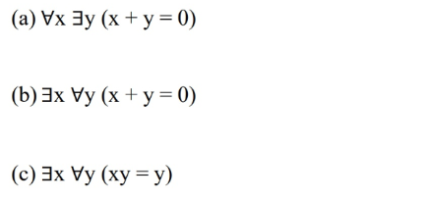
Questions:
The domain for all variables in the expressions below is the set of real numbers. Determine whether each statement is true or false. Justify your answer.

Slide 14
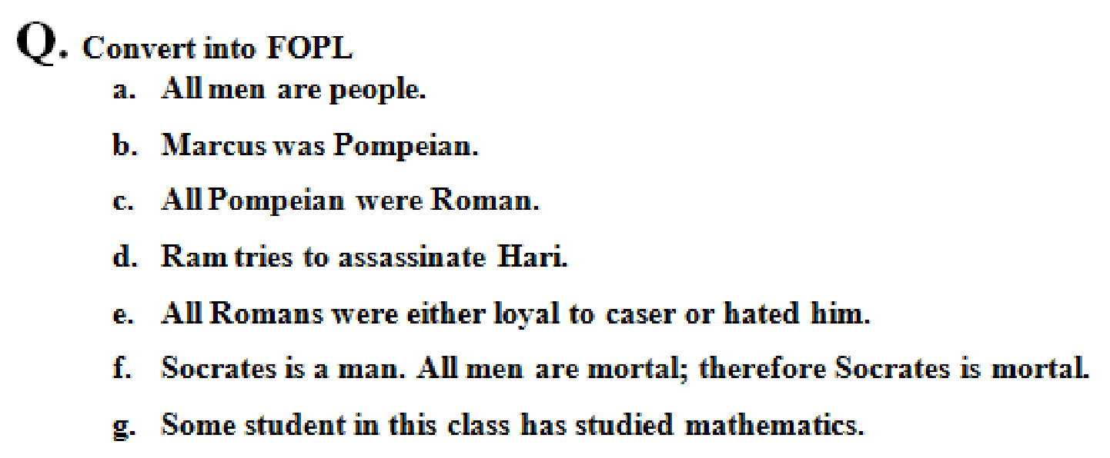

Slide 15
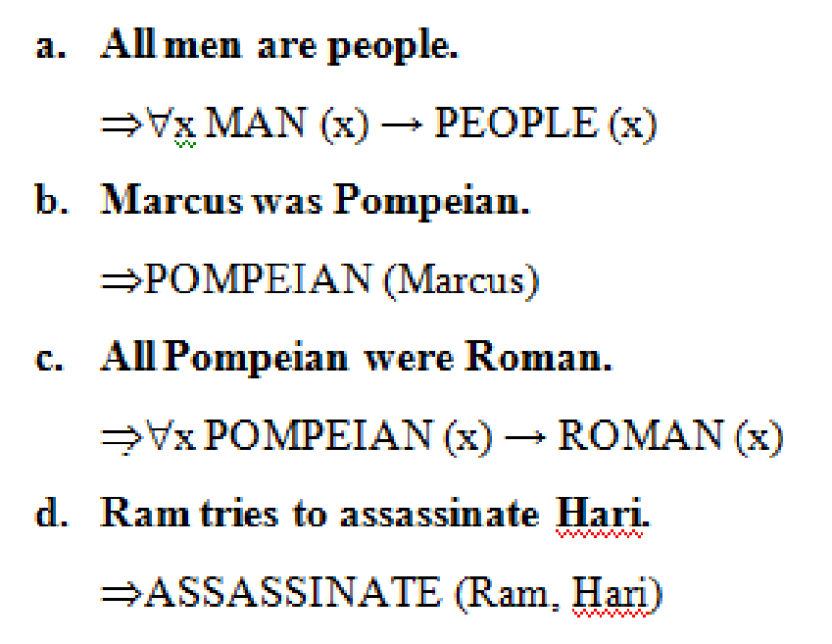

Slide 16
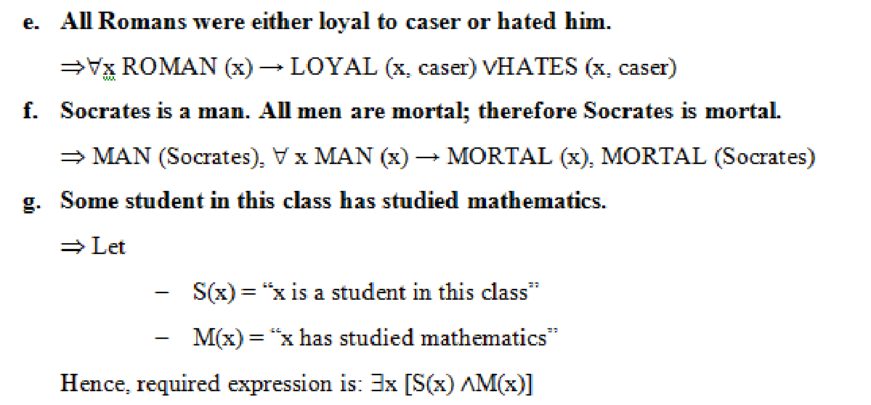

Slide 17
Introduction to Induction
Mathematical induction is an extremely important proof technique that can be used to proof mathematical theorems or statements.
It is a technique for proving results or establishing statements for natural numbers.

Slide 18
Mathematical Induction
Mathematical Induction is a mathematical technique which is used to prove a statement, a formula or a theorem is true for every natural number.
The technique involves two steps to prove a statement, as stated below –
To prove a result P(n) using the principle of mathematical induction
Step 1 (Base step) − It proves that a statement is true for the initial value. i.e. prove that P(1) holds.
Step 2 (Inductive step) − Then we assume that P(k) holds for some natural number k, and using this hypothesis, we prove that P (k+ 1) is true. If P(k+1) holds true, then the statement P(n) is true.

Slide 19
Example
Q. Use mathematical induction to prove that n³-n is divisible by 3 where n is a positive integer.
Solution:
Let p(n) denote the proposition: n³-n is divisible by 3.
Base step: Let p(n) is true for n=1
i.e. p(1): 1³-1=0, is divisible by 3.

Slide 20
Induction step:
Let p(n) is true for n=k.
i.e. p(k): k³-k is divisible by 3.(Assumption)
Now, using p(k) we try to show that p(n) is true for n=k+1.
P(k+1)= (k+1)³-(k+1)
= k³+ 3k²+3k+1-k-1
= (k³-k)+3(k²+k)
Since, both terms in this sum are divisible by 3.
Therefore, using principle mathematical induction, n³-n is divisible by 3 whenever n is a positive integer.

Slide 21
Question
1. Prove that 3 divides n³+2n whenever n is a nonnegative integer.

Slide 22
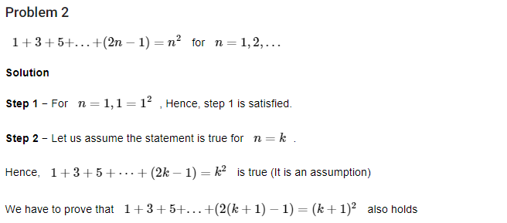
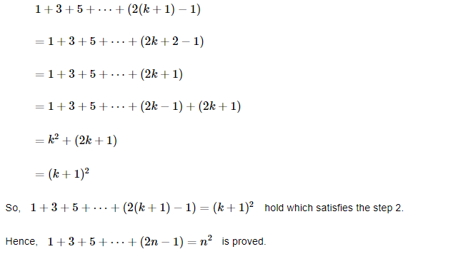

Slide 23
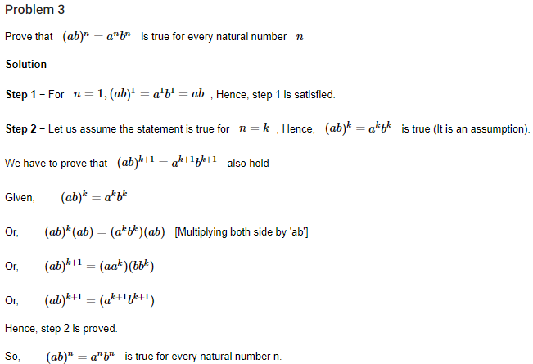

Slide 24
Problem 4
Prove that 1 + 2 + 3 + 4 + 5 + .... + n = n(n+1)/2.
Solution: Suppose P(n): 1 + 2 + 3 + 4 + 5 + .... + n = n(n+1)/2
Base Step: To prove P(1) is true.
For n = 1, LHS = 1
RHS = 1(1+1)/2 = 2/2 = 1
Hence LHS = RHS ⇒ P(1) is true.
Assumption Step: Assume that P(n) holds for n = k, i.e., P(k) is true
⇒ 1 + 2 + 3 + 4 + 5 + .... + k = k(k+1)/2 --- (1)

Slide 25
Induction Step: Now we will prove that P(k+1) is true.
To prove: 1 + 2 + 3 + 4 + ... + (k+1) = (k+1)(k+2)/2
Consider LHS = 1 + 2 + 3 + 4 + ... + (k+1)
= 1 + 2 + 3 + 4 + ... k + (k+1)
= (1 + 2 + 3 + 4 + ... + k) + k+1
= k(k+1)/2 + k+1 [Using (1)]
= [k(k+1) + 2(k+1)]/2
= (k+1)(k+2)/2
= RHS
⇒ P(n) is true for n = k+1
Hence, by the principle of mathematical induction, P(n) is true for all natural numbers n.

